Slide 1
Supporting Autistic Children
An Introduction for
Health and Social Care Practitioners

Slide 2
Overview
This learning tool has been developed to support professionals working with children with autism spectrum disorder. Based on the identified needs of professionals in Wales, and recommendations from the National Institute of Care and Excellence (NICE), this learning tool provides a useful introduction, and should be used as precursor to more in depth training.
After completing this learning, you are invited to complete the certification scheme at www.AutismWales.org, after registering you will be prompted to answer 20 multiple choice questions.
Successful completion of these will prompt download of your certificate.
Many resources to support the recommendations made in this learning tool are available at www.AutismWales.org, we have marked these with a * to help you.

Slide 3
Autism is a ‘hidden disability’, meaning it is not easy to recognise when someone has the condition. When you see the following pattern (on a wristband, card or mobile device) it means someone has autism and wants you to know so that you can support them:
Individuals with autism have difficulty in accessing services. Support from staff can make a huge difference, understanding autism has the power to change lives. The information to follow is provided to help you to understand autism and ways in which you can support children and adults with the condition to access your provision.

Slide 4
This learning tool aims to improve knowledge and understanding of ASD, and also to provide practitioners with advice about how to adapt their interactions and practice. These have been colour coded throughout as follows:
Knowledge Development
Practitioner Advice
Adapting Your Practice

Slide 5
Knowledge Development –
Autism Spectrum Disorders
It is estimated that 1 in every 100 people in the UK have an Autism Spectrum Disorder (ASD)
ASD is a lifelong condition and affects people from all backgrounds
ASD affects more males than females, though we are aware that many females with an ASD are overlooked

Slide 6
Knowledge Development –
Autism Spectrum Disorders
Autism Spectrum Disorders are also known by other
names, including:
Autism
Asperger’s Syndrome
Autism Spectrum Conditions
Childhood Autism
Pervasive Developmental Disorder

Slide 7
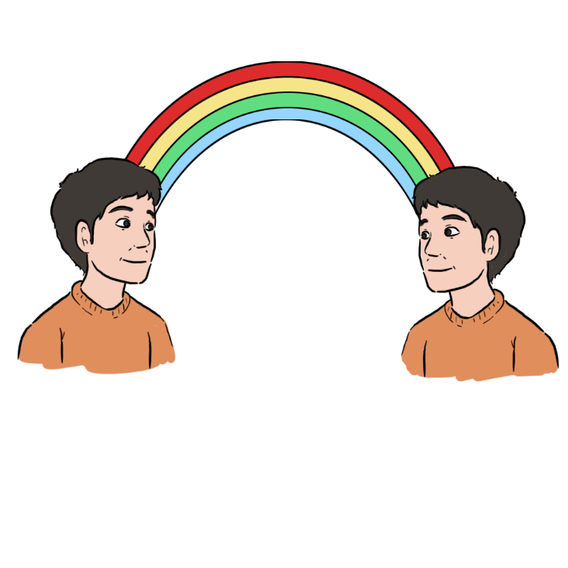
Knowledge Development –
Autistic Spectrum Disorders
We refer to an Autism ‘Spectrum’ because of the way in which the condition affects individuals can vary
On one end of the spectrum people with an ASD may have an additional learning disability and be more severely impaired.
On the other end individuals may have an average or above average intellect and may function at a higher level, but still experience difficulties.

Slide 8
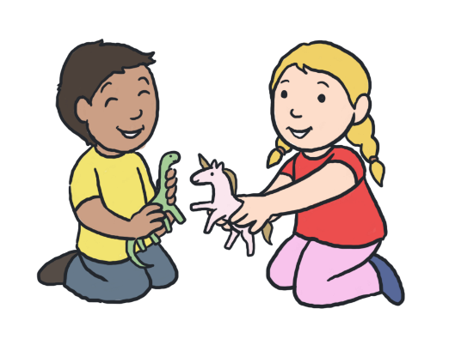
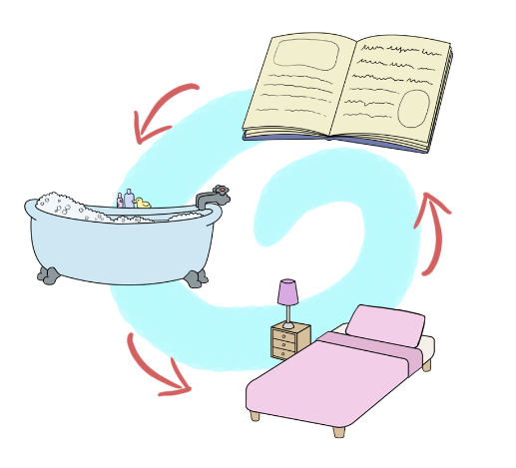
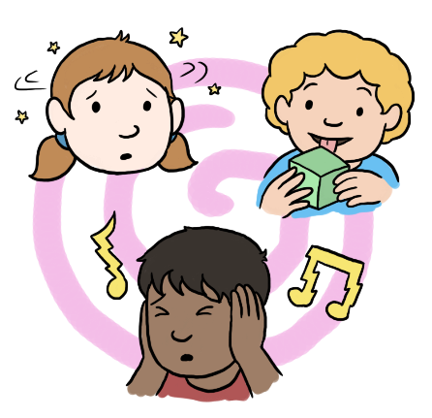
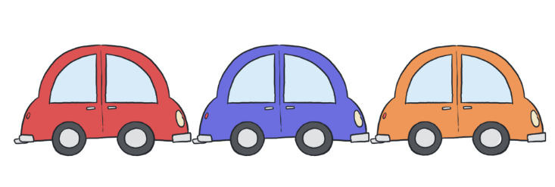
Knowledge Development –
Autism Spectrum Disorders
Individuals with an ASD have impairments in the following areas:
And may also demonstrate:
Social Communication
Social Imagination and Flexibility of Thought
Social Interaction
restricted or repetitive patterns of behaviour
Restricted, repetitive interests or activities
Unusual sensory responses

Slide 9
Knowledge Development –
Autism Spectrum Disorders
Some children with an ASD may not have been assessed for the condition and therefore may not have a diagnosis.
They may present with support needs, but have an underlying ASD that has not been recognised – these may present as:
Mental health issues or other neurodevelopmental disorder
Including anxiety, depression, psychosis and ADHD.
Rigid and repetitive behaviours
Including odd or unusual activities and mannerisms, rigid routines, repeating words and phrases, unusual highly focussed interests which may seem odd.
Unusual level of distress caused by a change or changes
Difficulties in school
Issues stemming from problems with social communication and interaction
Including change of schools, teacher or parental separation as well as day to day changes.
Including challenging behaviour, difficulties with unstructured tasks or conforming with social rules.
Difficulties with friendships, social isolation, frequent social misunderstandings and mistakes.

Slide 10
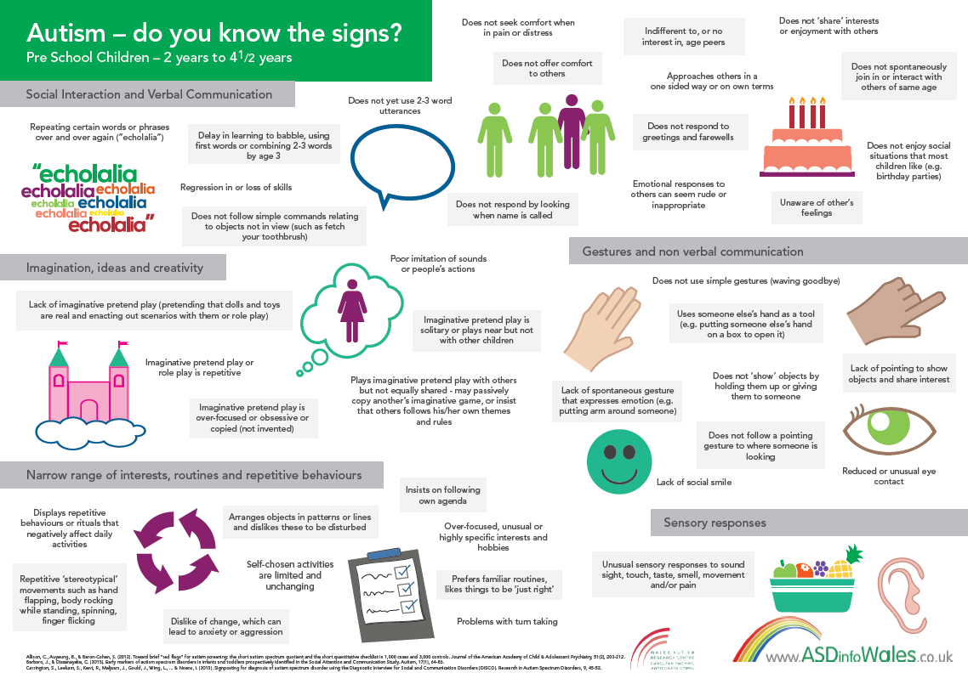
Knowledge Development –
Autism Spectrum Disorders

Slide 11
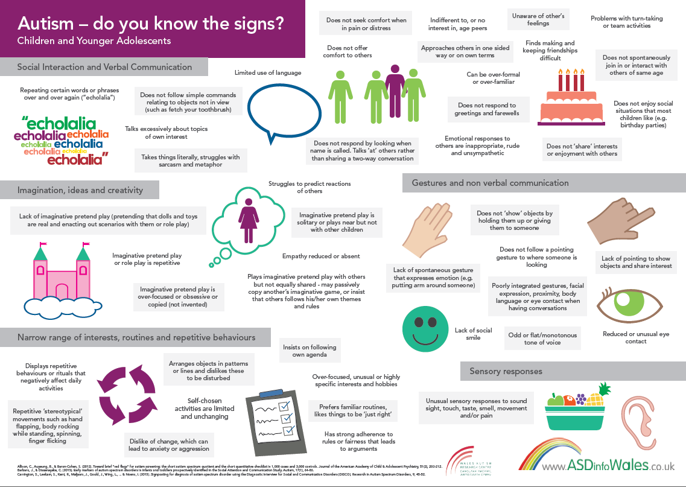
Knowledge Development –
Autism Spectrum Disorders

Slide 12
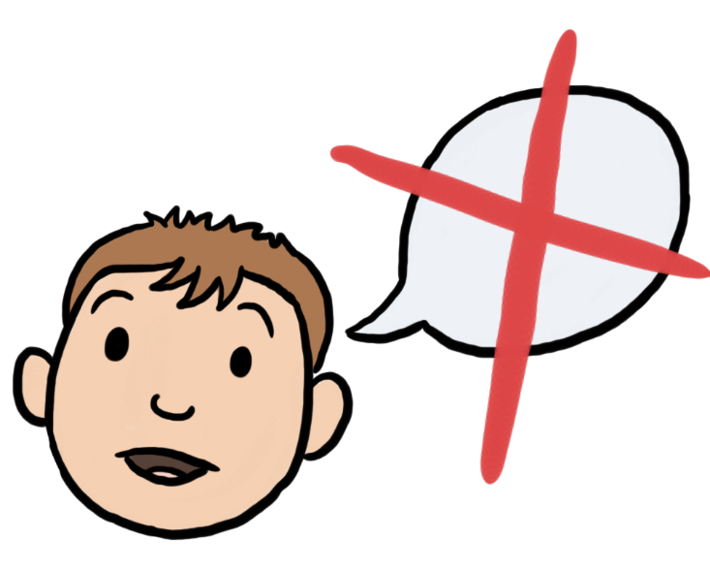
Knowledge Development –
Social Communication
Children with an ASD have impairments in social communication.
The way in which each child is affected varies.
These impairments can include difficulties in using
and understanding:
speech
gestures
language
tone of voice
eye contact

Slide 13
How this impacts on day to day life:
Knowledge Development –
Social Communication
A child with ASD may not be able to use gesture or interpret others gestures.
In order to understand when someone is being sarcastic, we analyse many non verbal cues. This means that children with ASD may struggle to recognise and appreciate sarcasm.
Children may not ‘point’ or may not be able to ‘follow a point’.
We often rely on tone of voice, gesture and eye contact as well as words to convey out point. Children with ASD may not be able to use or understand these easily.
Children with ASD may interpret language literally and so may misunderstand understand idioms (“pull your socks up”) and metaphors (“my head was spinning”).
Avoiding eye contact maybe interpreted as the child being rude, it is not.

Slide 14
Practitioner Advice –
Social Communication
Don’t use figurative language, avoid idiom and metaphor
Use visual cues such as pictures, lists or written material to support your interaction*
Say what you mean, and mean what you say
Use a calm, consistent tone of voice
Don’t rely on non verbal communication to convey or emphasise a point
Don’t make assumptions about feelings based on body language, facial expression or eye contact
Allow extra time for the child to process what you are saying
Keep your facial expressions to a minimum to avoid confusion
Be specific, and check that the child has understood you

Slide 15
Knowledge Development –
Social Interaction
Children with an ASD have impairments in social interaction. The way in which the person is affected varies. These impairments can include difficulties in :
sharing
giving and receiving compliments
offering comfort to others
taking turns in conversation
recognising humour or sarcasm
building and sustaining friendships

Slide 16
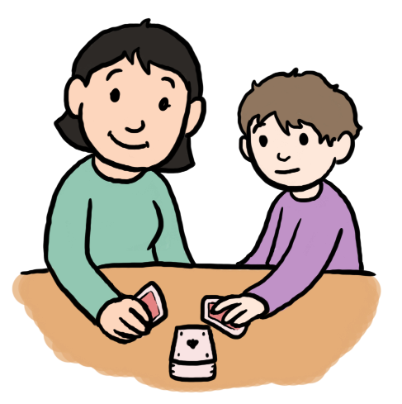
How this impacts on day to day life:
Knowledge Development –
Social Interaction
Children with ASD find it difficult to develop and maintain friendships. This does not mean that they do not want friends.
Children with ASD have difficulty in understanding the rules of social interaction. This may cause many issues including them appearing to be aloof or overfamiliar, not respecting personal space or making personal remarks without realising they have offended.
Children may find taking turns in conversation difficult, and may be more interested in what they are saying than what others are saying.
Children with ASD may find it difficult to understand the social purpose of sharing, and this can impact on their relationships with other children.
Children with ASD may find it difficult to guess how others may be feeling and respond appropriately or to show empathy and offer comfort.

Slide 17
Practitioner Advice –
Social Interaction
Explain your role and the purpose of interaction before starting
Clearly and closely explain your expectations of the child, avoid lengthy, complicated explanations
Do not offer telephone only support, many individuals with ASD find this form of interaction very difficult
Beware of the child’s difficulties in interacting in groups, they may need to be avoided or supported with additional structure*
Ask specific questions, many individuals with ASD will rarely offer more information than they asked for and you could be missing something essential
Reduce social niceties, and social chit chat , focus on facts and purpose

Slide 18
Knowledge Development –
Social Imagination, Restricted or Repetitive Behaviours and Interests
Children with an ASD have impairments in social imagination and flexibility of thought and demonstrate restricted, repetitive patterns of behaviour. Again, the extent varies from one child to another.
The impact of this can be affect many areas of daily life and may include difficulties in:
predicting reactions and events
play
planning
problem solving
creative activities
coping with changes

Slide 19
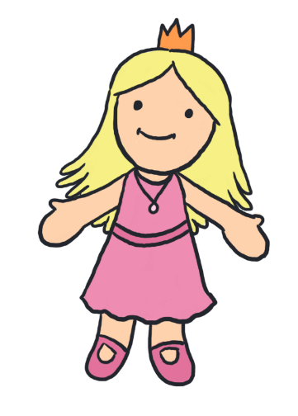
How this impacts on day to day life:
Knowledge Development –
Social Imagination, Restricted or Repetitive Behaviours and Interests
Some children with ASD have difficulties with areas of creative imagination. This can impact on school and home activities.
Problem solving can be difficult and the individuals may need additional support or structure with this.
Children may be unable, or have limited ability, to engage in imaginative play.
Children with ASD may find it difficult to understand how their behaviour impacts on others.
Many children may insist on sameness or have ritualised patterns of behaviour, this makes it difficult to cope with changes, unfamiliar people and activities which can lead to anxiety.
Planning and organising can cause problems and many will need additional support with this. Longer or grouped tasks will need to be broken down into smaller steps.
Repetitive behaviours such as spinning, finger flicking or rocking can impact on friendships.

Slide 20
Practitioner Advice –
Social Imagination, Restricted or Repetitive Behaviours and Interests
Keep changes to a minimum, be consistent in your interactions
Provide additional structure within activities that are complex or that rely on social imagination
Engage in structured games and activities with clear rules rather than imaginative play
Provide structure in the form of planners, lists or timetables*
Offer a limited number of choices rather than free choice
Describe your planned actions, do not assume that the individual will recognise what is expected of them based on your body language or movements

Slide 21
Practitioner Advice –
Social Imagination, Restricted or Repetitive Behaviours and Interests
Special interests
Restricted patterns of behaviour can often manifest as the individual having an intense, restricted or fixated interest.
Sometimes the intensity of the interest can cause an impact on daily functioning, impair social opportunities and cause distress for those caring for the child.
It is useful to remember that for the child with an ASD, these interests are often comforting and reassuring. Professionals can utilise these interests as a foundation for building a relationship, as a reward for positive behaviour or an opportunity for relaxation.

Slide 22
Knowledge Development –
Unusual Sensory Responses
Many children with an ASD have sensory issues.
The child’s perception of the senses can be heightened
or decreased. All the senses can be affected:
tactile
(touch)
vestibular
(movement)
proprioceptive
(body position)
visual
auditory
(looking)
olfactory
(hearing)
gustatory
(smell)
(taste)

Slide 23
How this impacts on day to day life:
Knowledge Development –
Unusual Sensory Responses
decreased feelings of pain
sensitivity to lighting in shops
difficulties around noisy traffic
inability to tolerate certain smells
food fads / limited diet
distress / anxiety in busy environments
sensitivity to touch

Slide 24
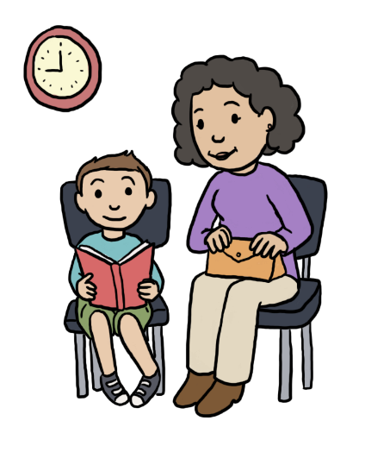
Practitioner Advice –
Unusual Sensory Responses
How you should adapt your practice:
Use a calm, consistent tone of voice
Reduce lighting, switch off fluorescent lights
Look for sensory triggers when looking for causes of distress
Don’t rely on the child’s recognition or description of pain to assess an injury
Avoid tasks that require using two or more senses at once such as taking notes whilst listening to you
Choose less busy times of day or environments where possible

Slide 25
Adapting Your Practice –
Duties
Services have a duty to make ‘reasonable adjustments’ to their practice for children with an ASD.
Most of the adjustments outlined here are low or no cost options, and would therefore be considered as ‘reasonable’.
More importantly, making these changes to your practice can improve engagement, reduce distress and essentially mean that the child is supported to reach their full potential.

Slide 26
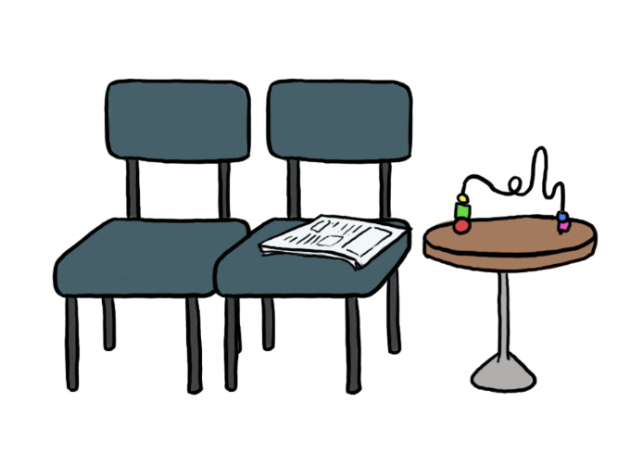
Adapting Your Practice –
Appointments
Attending and waiting for appointments can often be
very stressful for a child with an ASD
Offer appointments at less busy times of day
Offer a quieter area to wait in
Try to keep appointments to time, if running late ask someone to let the child / family know
Dim lights and switch off fluorescent lighting
Aim for a sensory neutral environment, choose neutral colours and avoid cluttering walls with posters and leaflets

Slide 27
Adapting Your Practice –
Assessments
Due to the range of impairments that children with ASD experience, assessments activity will need to be adapted to ensure accurate
information is obtained
Don’t rely on the child’s description of pain or illness as this may be more severe than reported
Ask specific questions, don’t assume the child will realise what you are implying
Explain the purpose, your role and expectations clearly
Adapt your communication, avoid figurative language and be specific
Utilise visual cues such as pictures, lists and flowcharts
Don’t make assumptions based on body language, facial expression or eye contact
If the child is struggling to describe emotions, support them by asking for physical feelings or use a rating scale

Slide 28
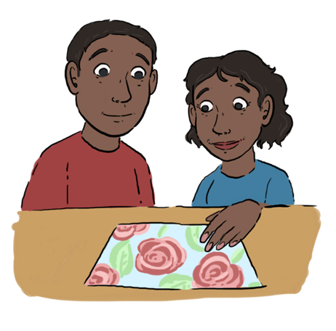
Adapting Your Practice - Interventions
Interventions will need to be adapted when used with children with an ASD
Add more structure to any interventions, especially self directed work
Consider if the child can undertake work at home, the child may find it difficult to complete tasks set in one environment in another
Engage parents and carers to support work
Break down large tasks into smaller steps
Clearly explain any physical interventions, and don’t rely on body language to convey your intentions
Be patient, allow child to explore equipment and surroundings and gradually build to any intervention
Utilise visual cues such as pictures, planners, checklists, diaries and flow charts
Use facts, avoid hypothetical discussions and be aware of the difficulties the child will have in sharing emotions

Slide 29
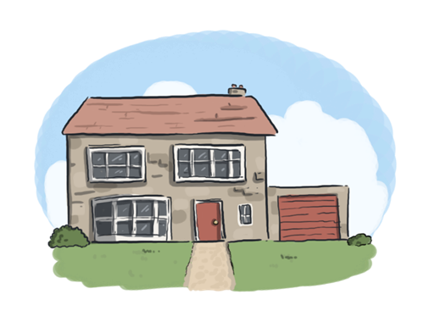
Adapting Your Practice –
Follow up
Referring on, or visiting in different environments
Prepare the child for changes to usual contact such as school or home visits
Explain purpose and expectations of any future contact so that the child is clear about what is expected of them
Ensure child is clear of any tasks expected of them, and that they have a clear ‘end point’
If referring to a different service / professional advise them of the child's difficulties in advance
Provide a profile* of the child’s needs in collaboration with parents and carers so that other professionals are advised of needs
Ensure any written information has been adapted for children with an ASD

Slide 30
further information and links to other resources can
be found at
or email enquiries to AutismWales@WLGA.gov.uk

